Slide 1
AI by Lavika Goel Chapter 3
9th Feb 2023

Slide 2
3.1 Introduction
Many problems in AI are complex and require appropriate search methods.
It is imperative to discuss different heuristic search methods that can be described independently of any particular task or problem domain.
Combinatorial explosion which is very common with most search processes can be overcome by estimating heuristics based on domain specific knowledge.
The heuristic techniques that will be discussed in this chapter include:
Generate and test method
Hill climbing method
Best first search
Problem reduction
Constraint satisfaction
Means end analysis

Slide 3
3.2 Generate and test method
If the problem can be broken down into sub-problems and sub-problems can be solved independently then the solution the problem is the combination of solutions to the sub-problems.
This combination can be represented using AND/OR graph.
The generate and test method searches the problem space exhaustively to find a solution.
It guarantees to find a solution if done in a systematic manner.
Generate and test algorithm:
Randomly generate an arbitrary solution.
Check if the solution satisfies the problem.
If yes, then quit. Otherwise return to step 1.
Some approaches even go for random search of solutions and this approach is called British Museum Algorithm

Slide 4
3.2 Generate and test method
The approach that searches exhaustively and also searches randomly finds the solution faster.
This approach is based on heuristic function and it is the most systematic and practical approach.
This algorithm skips the paths that it knows that would never lead to the solution, thus making the process faster.
The process of removing certain paths is known as planning.
This approach, though promising, sometimes leads to incorrect solution and hence is a trade-off between practicality and accuracy.
Generate and test method is similar to human cognition

Slide 5
3.3 Hill Climbing Method
This is an optimization and local search algorithm.
This algorithm uses a single current state and move to neighbouring states in search for better solution.
It starts with an initial random solution and keeps improving it incrementally until we find an acceptable solution.
This strategy required less memory and finds reasonable solution in a large search space.
This algorithm doesn’t backtrack since it doesn’t keep track of the states it has previously visited.
Hill Climbing finds local optima if the problem is not convex. To find global optima, some of the methods used are:
Random restart
Simulated annealing

Slide 6
Simulated Annealing
Based on probability function
In simulated annealing, after finding local maxima, the algorithm backtracks to a certain state in order to find an even better state like shown in the graph based on probability function.

Slide 7
3.3 Variants of Hill Climbing
Steepest ascent hill climbing: This looks at all the neighbours and then makes the transition to a best option.
Simple or stochastic hill climbing: This looks for a better state than the current state and not necessarily all the neighbouring states.
Shotgun hill climbing: This does multiple runs of the algorithm, each time with a random initial state in hopes of achieving global optima.

Slide 8
3.3 Hill Climbing
Issues
Getting stuck at local minima
Plateaus: these are the regions which are flat, which means objective function has the same value in the neighbouring state. One possible solution to this issue is to have algorithm move sideways until it encounters an uphill. However, it has to be taken care that algorithm doesn’t get stuck in an infinite search.
Ridges and valleys
Solutions
In order to overcome these problems, following methods or combination of these methods can be considered:
Backtracking and going in other direction
A big jump to go to new section to escape from plateau
Trying different paths at the same time for overcoming ridges.

Slide 9
3.3 Hill Climbing
There are many applications of hill climbing such as traveling salesman problem, eight queens problem, network flow problems, etc.
Hill climbing is a variant form of the generate and test algorithm.
Hill climbing = generate and test + heuristics

Slide 10
3.4 Best First Search and A* Search
It is important to search graphs so that duplicate paths will not be searched.
To accomplish this, algorithm makes use of directed graph where each node represents a point in problem space and contains:
Problem state description
Indication of how promising it is
Parent link
Child nodes
Parent link ensures the path recovery once goal is found.
The list of successor nodes make it possible to propagate the improvement down to its successors, if a better path is found and this is called OR graph.
Best first search selects the best possible path based on heuristic function.
Best first search differs from hill climbing in the following ways:
In hill climbing, one path is selected and remaining are ignored. Here we keep track of all possible paths.
In best first search, we move to the best possible state even if its value is not lower than the current state.
Best first search is BFS with priority queue.

Slide 11
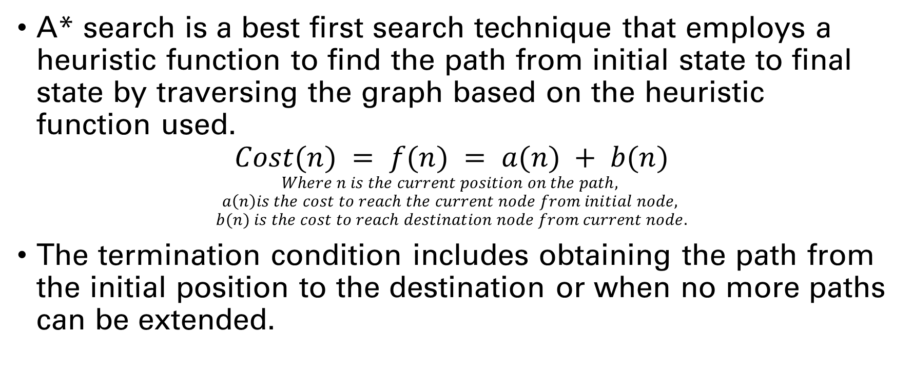
3.4.1 A* Search algorithm
A* search is a best first search technique that employs a heuristic function to find the path from initial state to final state by traversing the graph based on the heuristic function used.
$$Cost(n) = f(n) = a(n) + b(n)$$
$$Where n is the current position on the path,$$
$$a\left(n\right)is the cost to reach the current node from initial node,$$
$$b(n) is the cost to reach destination node from current node.$$
The termination condition includes obtaining the path from the initial position to the destination or when no more paths can be extended.

Slide 12
3.4.1 Methods to determine b(n)
Exact value of b(n): to calculate the exact value of heuristic function b(n), these steps have to be followed:
Exact value distances of all pairs have to computed beforehand.
If there are no blocking entities in the path between current and final node, the distance can be computed using Euclidean or Manhattan distances.
Approximated value of b(n): it can be computed using:
Manhattan distance
Diagonal distance
Euclidean distance

Slide 13
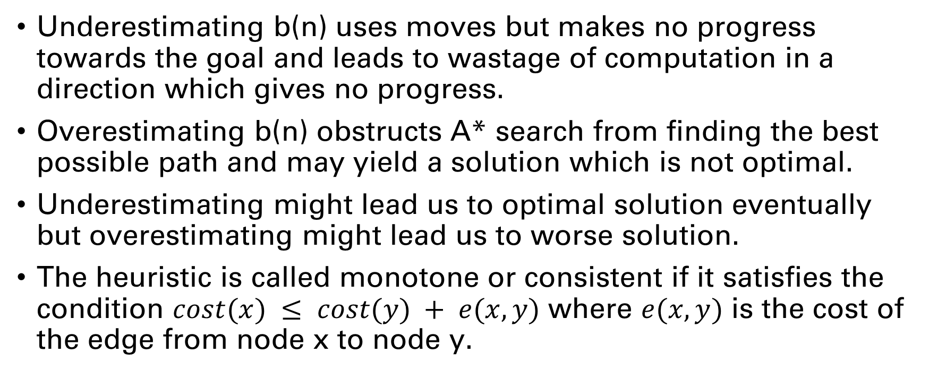
3.4.1 Over and under estimation of b(n)
Underestimating b(n) uses moves but makes no progress towards the goal and leads to wastage of computation in a direction which gives no progress.
Overestimating b(n) obstructs A* search from finding the best possible path and may yield a solution which is not optimal.
Underestimating might lead us to optimal solution eventually but overestimating might lead us to worse solution.
The heuristic is called monotone or consistent if it satisfies the condition $cost(x) ≤ cost(y) + e(x, y)$ where $e(x, y)$ is the cost of the edge from node x to node y.

Slide 14
3.5 Means end analysis
It is a technique used in AI to reduce the search space, thus improving the effectiveness of the algorithm in finding a solution.
This technique tries to look for solution that tends to minimize the difference between the current and goal state through different operators.
It allows for both forward and backward searching.
Means end analysis algorithm is recursive algorithm:
Step 1 – Compare current to goal, if there are no differences between them, then return.
Step 2 – Select the most important difference and reduce it by doing the following unless success or failure is signalled.
Select an untried operator O to current state, signal failure if there is no such operator.
Generate O-start and O-result for current state before applying operator O.
If
First-Part = MEA(current, O-start)
Second-Part = MEA(O-result, goal) are successful, then signal success and concat(First-Part, O, Second-Part) gives the result.

Slide 15
3.5 Means End Analysis
Operators:
Move (M): Moves the object outside of the enclosing object.
Shrink (S): Decreases the size of the object.
Expand (E): Increases the size of the object
Initial state
Final state
E
M
S
Initial state
Final state

Slide 16
3.6 Intelligent Agents and Environment
An intelligent agent is an entity that consists of
Sensors
Effectors
Terminologies
Performance of an agent
Behavior of an agent
Percept
Percept sequence
Agent function

Slide 17
3.6.2 Rationality of Agents
Rationality is the status of having good sense of judgement in regard to obtaining the information from the environment by performing certain actions.
A rational agent has a tendency to provide the most optimal solution based on the data collected using previous results and the data it fetches in current scenario.
The rational agents are characterized by 4 properties.
Performance measure
Percept sequence
Information about the environment
Actions of the agent

Slide 18
3.6.3 Types of Agents
Simple reflex agent: These agents perform actions on the basis of the current perception of the environment. Ex: Robot that sorts the mail according to the pin code, robot that cooks food.
Model based agents: These agents use a model to depict the world and choose the actions accordingly by maintaining an internal state. These agents require evolution information about the world in order to update the model.
Goal based agents: These agents choose actions in order to get to the desired state.
Utility based agents: These agents choose actions on the basis of the preference for states.

Slide 19
3.6.4 Properties of an Environment
Discrete or continuous
Observable or partially observable
Static or dynamic
Single or multiple agents
Accessible or inaccessible
Deterministic or non-deterministic
Episodic or non-episodic

Slide 20
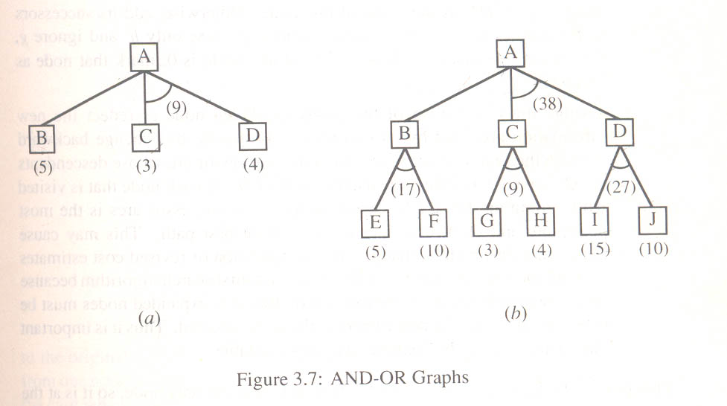
3.7 Problem Reduction, AO* Algorithm

Slide 21
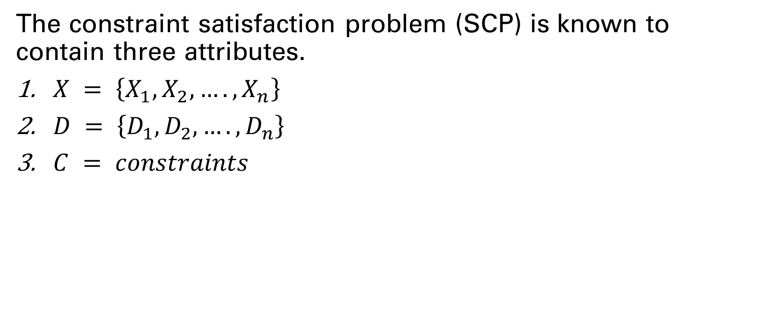
3.8 Constraint Satisfaction
The constraint satisfaction problem (SCP) is known to contain three attributes.
$X = \left\{X_{1},X_{2},….,X_{n}\right\}$
$D = \left\{D_{1},D_{2},….,D_{n}\right\}$
$C = constraints$

Slide 22
3.8.1 Inference in CSP
Constraint propagation is the inference technique used to minimize the possible values for a variable, thus creating a chain of reduced possible values for other variables as well.
It can be used either while searching or as pre-processor to reduce space utilization.
The graph is modelled with variables as nodes and constraints as the edges between nodes and it is important to maintain local consistency.
Node consistency
Arc consistency

Slide 23
3.8.2 Backtracking for CSP
A CSP can be solved using DFS, where a state is partial assignment and an action is adding var (value to the assignment).
CSPs have commutative property
Backtracking is used on the search tree by assigning values to the variables one at a time. Backtracking is used in case no legal value is available for some variable.
Strategies to select next unassigned variable:
Minimum remaining values heuristic
Least constraining value

Slide 24
R
R
R
G
B
R
G

Slide 25
3.8.3 Local Search for CSP
In local search, initially, all the variables are assigned some values, then the search algorithm tries to change the value of one selected variable in one time unit.
Min-conflict heuristic is used to choose a new value
Tabu search is a technique used to solve min-conflict-heuristic’s plateau problem.
Constraint weighting is used to concentrate search on some important constraints.

Slide 26
3.9 Local Beam Search
Step 1 – Generate K initial states
Step 2 – successors of these K states are generated
Step 3 – if any state formulated is goal state then halt
Step 4 – Select top k states and back to step 1

